Slide 1

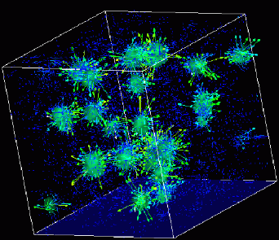
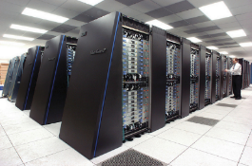
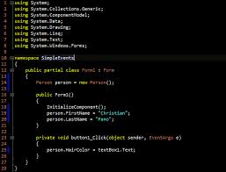
Advanced
Scientific Computing
(SciComp 201)
Session 09 Instrumentation, Representation

Slide 2
Session Goals
Use the high precision clock() function to carefully measure the elapsed run time of algorithms
Make systematic improvements in the algorithm to improve code performance because in SciComp speed & accuracy are paramount
Consider representation theory & uncover patterns in observed data to reduce the required search space

Slide 3
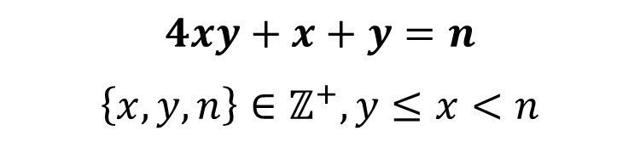
Representation Theory
For a given integer n, how many ways can n be represented by ordered pairs (x, y) according to the form:
If there are no orders pairs then n can not be represented by the given form
How might you search for all potential (x, y) pairs that can represent n in this form?
$$4xy+x+y=n$$
$$\left\{x,y,n\right\}∈ℤ^{+}, y≤x<n$$

Slide 4
Instrumenting Your Code
Instrumenting code is the process of taking accurate timings of the runtime performance of key algorithms within the program
C++ provides a clock() function that captures the current system time which is accurate to the nearest millisecond (1/1000th of a second) which is sufficient in most situations
We bracket the code under analysis by measuring the clock immediately before the start and right at the end of the algorithm, and then calculate the elapsed time
Careful tracking of code timings will provide objective empirical evidence if changes to algorithms and/or data structures are indeed making the program more efficient

Slide 5
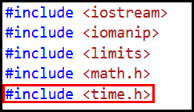
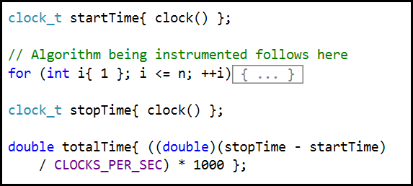
Instrumenting Your Code
stdafx.h
sourcecode.cpp

Slide 6
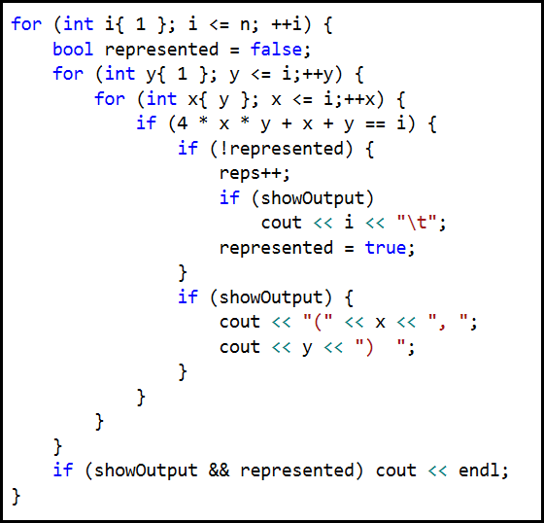
Lab 1 – Start Gap
BRUTE FORCE
Try all X and Y subject to the constraints of the form

Slide 7
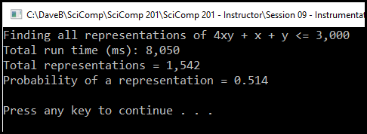
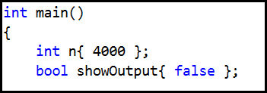
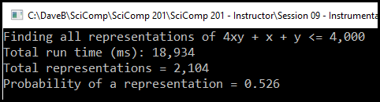
Lab 1 – Start Gap

Slide 8
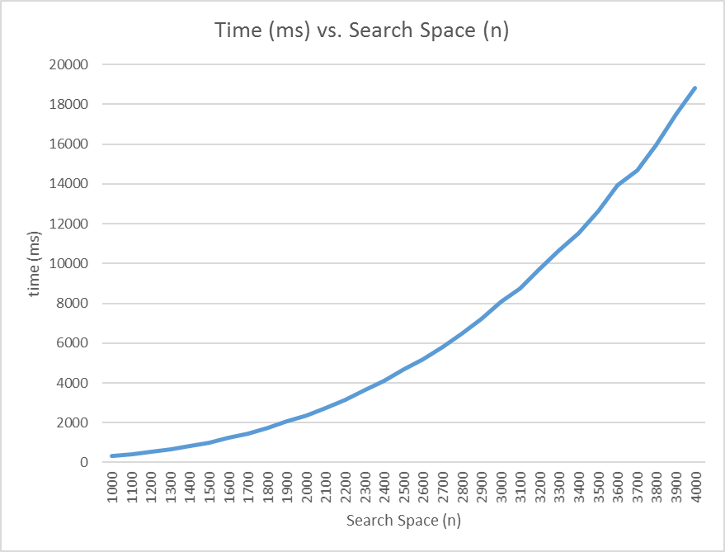
Exponential Growth in
Brute Force Search Time

Slide 9
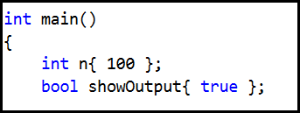
Lab 1 – Start Gap
What can be done to reduce the search space to find valid representations?
Is there some pattern with the ordered pairs we can leverage to avoid values for x which cannot possibly be a solution?
Change n to 100, and showOutput to true, then re-run lab 1

Slide 10
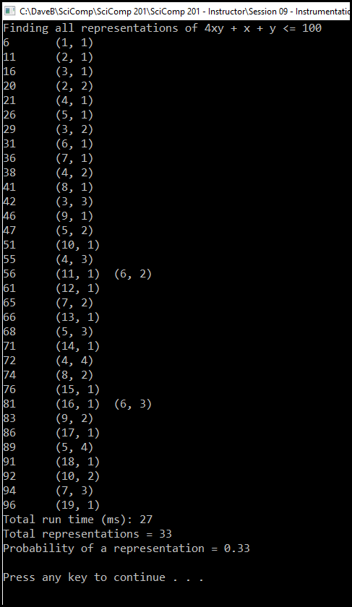
The “Start”
Can you find a formula that gives the n value whenever x = y in a solution pair?
The “Gap”
For each pair with a constant y (ex: y = 3), is there a formula that gives the next n value for the next x value?

Slide 11
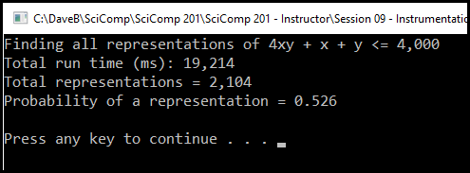
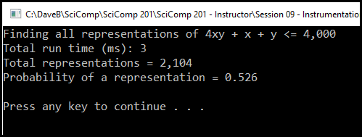
Representation Theory
Lab 1 - Start Gap
~6,400X faster!
Lab 2 - Start Gap 2

Slide 12
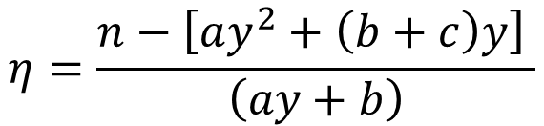





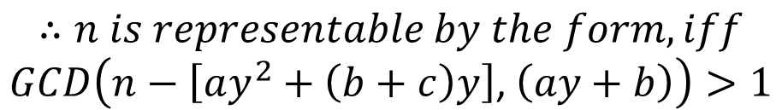
Representation Theory
$$axy+bx+cy=n$$
$$\left\{x,y,n\right\}∈ℤ^{+}, y≤x<n$$
$$let x=y+η⇒η∈ℤ$$
$$a\left(y+η\right)y+b\left(y+η\right)+cy=n$$
$$ay^{2}+ayη+by+bη+cy=n$$
$$η=\frac{n−\left[ay^{2}+\left(b+c\right)y\right] }{\left(ay+b\right)}$$
$$∴n is representable by the form, iff$$
$$GCD\left(n−\left[ay^{2}+\left(b+c\right)y\right]\text{,} \left(ay+b\right)\right)>1$$

Slide 13
The “Start”
Can you find a formula that gives the n value whenever x = y in a solution pair?
The “Gap”
For each pair with a constant y (ex: y = 3), is there a formula that gives the next n value for the next x value?

Slide 14
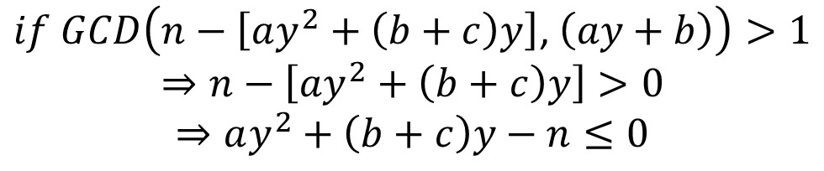

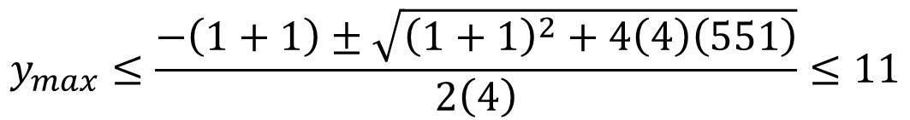
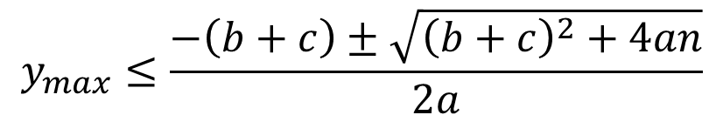
Representation Theory
$$if GCD\left(n−\left[ay^{2}+\left(b+c\right)y\right]\text{,} \left(ay+b\right)\right)>1 \\ ⇒n−\left[ay^{2}+\left(b+c\right)y\right]>0 \\ ⇒ay^{2}+\left(b+c\right)y−n≤0$$
$$y_{max}≤\frac{−\left(b+c\right)±\sqrt{{\left(b+c\right)}^{2}+4an}}{2a}$$
$$Is n=551 representable by 4xy+x+y?$$
$$y_{max}≤\frac{−\left(1+1\right)±\sqrt{{\left(1+1\right)}^{2}+4\left(4\right)\left(551\right)}}{2\left(4\right)}≤11$$
$$Only need to test 1≤y≤11$$

Slide 15
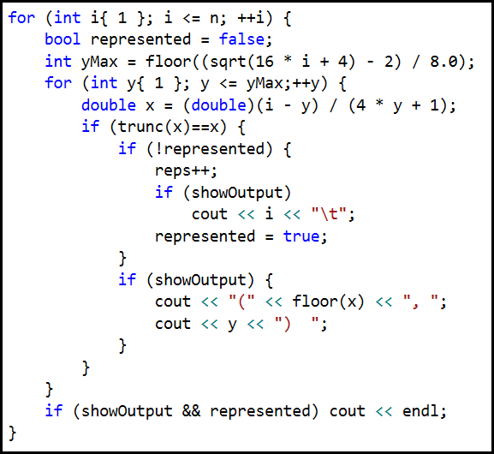
Lab 2 – Start Gap 2
Use yMax
For GCD > 1, x must be an integer, or trunc(x)==x

Slide 16
Now you know…
The clock() function returns a high precision time stamp accurate to the nearest millisecond
It requires that clock_t is defined, which is time.h header
We measure the elapsed time it takes the computer to complete an algorithm in your source code in order to determine areas requiring optimization
Vastly improving an algorithm often requires taking a step back to considering carefully if there are any patterns in the data we can leverage to avoid wasting time pursuing dead ends
Representation theory asks if a given number is somehow equal to a set of other numbers all obeying a formula

